Slide 1
Magellan (spacecraft)
From Wikipedia, the free encyclopedia
https://en.wikipedia.org/wiki/Magellan%20%28spacecraft%29
Licensed under CC BY-SA 3.0:
https://en.wikipedia.org/wiki/Wikipedia:Text_of_Creative_Commons_Attribution-ShareAlike_3.0_Unported_License

Slide 2
Magellan (spacecraft)
The Magellan spacecraft, also referred to as the Venus Radar Mapper, was a 1,035-kilogram (2,282 lb) robotic space probe launched by NASA of the United States, on May 4, 1989, to map the surface of Venus by using synthetic aperture radar and to measure the planetary gravitational field.
Magellan was the fifth successful NASA mission to Venus, and it ended an eleven-year gap in U.S. interplanetary probe launches.

Slide 3
History
Beginning in the late 1970s, scientists pushed for a radar mapping mission to Venus.
They first sought to construct a spacecraft named the Venus Orbiting Imaging Radar (VOIR), but it became clear that the mission would be beyond the budget constraints during the ensuing years.
In 1985, the mission was renamed Magellan, in honor of the sixteenth-century Portuguese explorer Ferdinand Magellan, known for his exploration, mapping, and circumnavigation of the Earth.

Slide 4
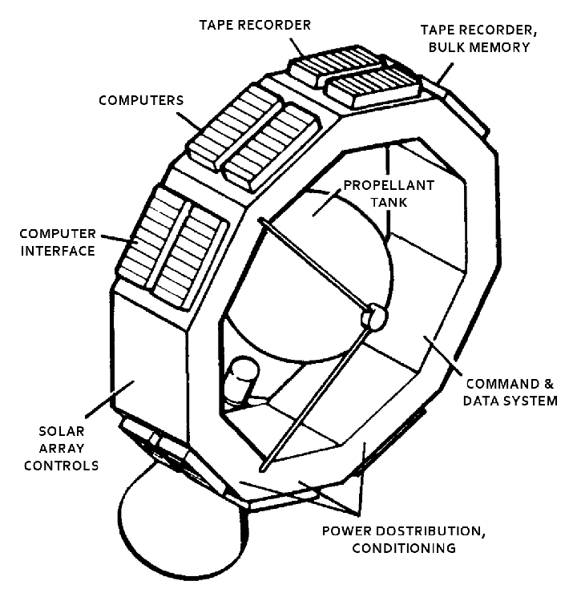
The spacecraft bus that formed the main body of Magellan

Slide 5
Spacecraft design
The spacecraft was designed and built by the Martin Marietta Company, and the Jet Propulsion Laboratory (JPL) managed the mission for NASA.
The main body of the spacecraft, a spare one from the Voyager missions, was a 10-sided aluminum bus, containing the computers, data recorders, and other subsystems.

Slide 6
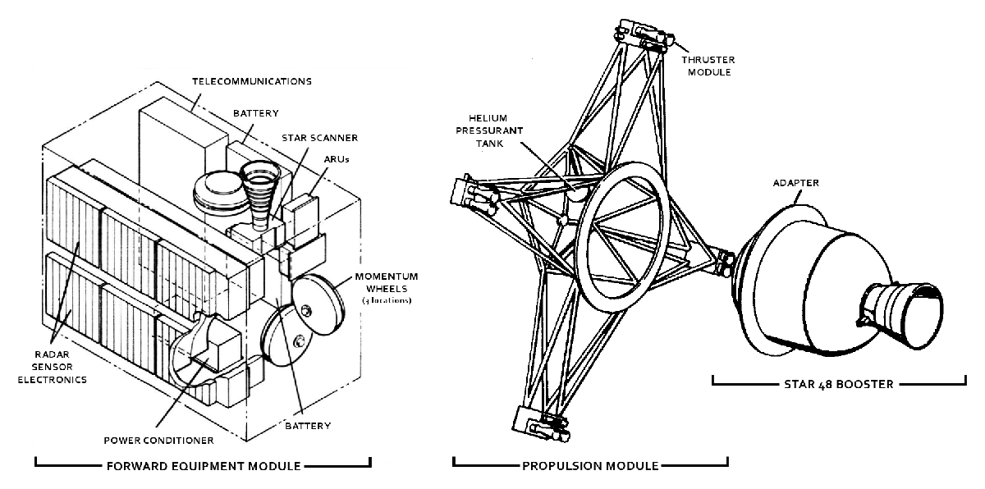
Thrusters, Star 48 booster and the internal components of the Forward Equipment Module

Slide 7
Attitude control and propulsion
The spacecraft's attitude control (orientation) was designed to be three-axis stabilized, including during the firing of the Star 48B solid rocket motor (SRM) used to place it into orbit around Venus.
Prior to Magellan, all spacecraft SRM firings had involved spinning spacecraft, which made control of the SRM a much easier task.

Slide 8
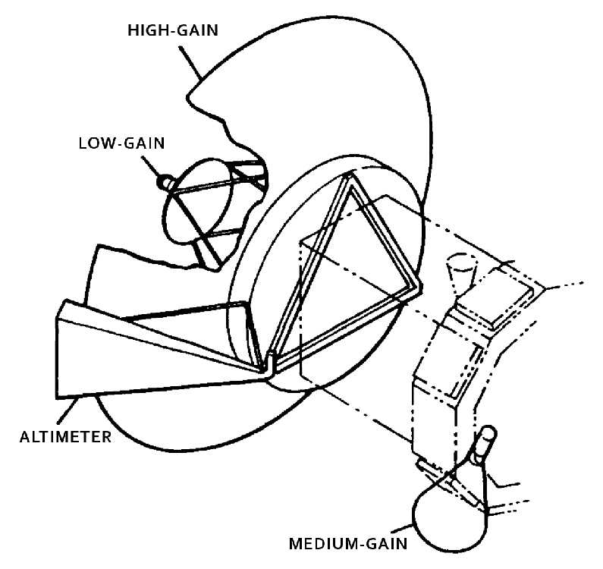
Positions of the three antennas

Slide 9
Communications
For communications, the spacecraft included a lightweight graphite/aluminum, 3.7-meter high-gain antenna left over from the Voyager Program and a medium-gain antenna spare from the Mariner 9 mission.
When communicating with the Deep Space Network, the spacecraft was able to simultaneously receive commands at 1.2 kilobits/second in the S-band and transmit data at 268.8 kilobits/second in the X-band.

Slide 10
Power
Magellan was powered by two square solar arrays, each measuring 2.5 meters across.
Together, the arrays supplied 1,200 watts of power at the beginning of the mission.
To power the spacecraft while occulted from the Sun, twin 30 amp-hour, 26-cell, nickel-cadmium batteries were included.
The batteries recharged as the spacecraft received direct sunlight.

Slide 11
Computers and data processing
The CDS was able to store commands for up to three days, and also to autonomously control the spacecraft if problems were to arise while mission operators were not in contact with the spacecraft.
For storing the commands and recorded data, the spacecraft also included two multitrack digital tape recorders, able to store up to 225 megabytes of data until contact with the Earth was restored and the tapes were played back.

Slide 12
Scientific instruments
The Magellan high-gain parabolic antenna, oriented 28°–78° to the right or left of nadir, emitted thousands of microwave pulses that passed through the clouds and to the surface of Venus, illuminating a swath of land.
To increase the imaging resolution, Magellan recorded a series of data bursts for a particular location during multiple instances called, "looks".

Slide 13
Other science
In addition to the radar data, Magellan collected several other types of scientific measurements.
These included detailed measurements of the Venus gravitational field, measurements of the atmospheric density, and radio occultation data on the atmospheric profile.

Slide 14
Gallery
Annotated diagram of Magellan
Magellan during pre-flight checkout
Magellan with its Star 48B solid rocket motor undergoing final checks at the Kennedy Space Center
Magellan being fixed into position inside the payload bay of Atlantis prior to launch

Slide 15
Launch and trajectory
Trajectory of Magellan to Venus

Slide 16
Orbital encounter of Venus
On August 10, 1990, Magellan encountered Venus and began the orbital insertion maneuver which placed the spacecraft into a three-hour, nine minute, elliptical orbit that brought the spacecraft 295-kilometers from the surface at about 10 degrees North during the periapsis and out to 7762-kilometers during apoapsis.
During each orbit, the space probe captured radar data while the spacecraft was closest to the surface, and then transmit it back to Earth as it moved away from Venus.

Slide 17
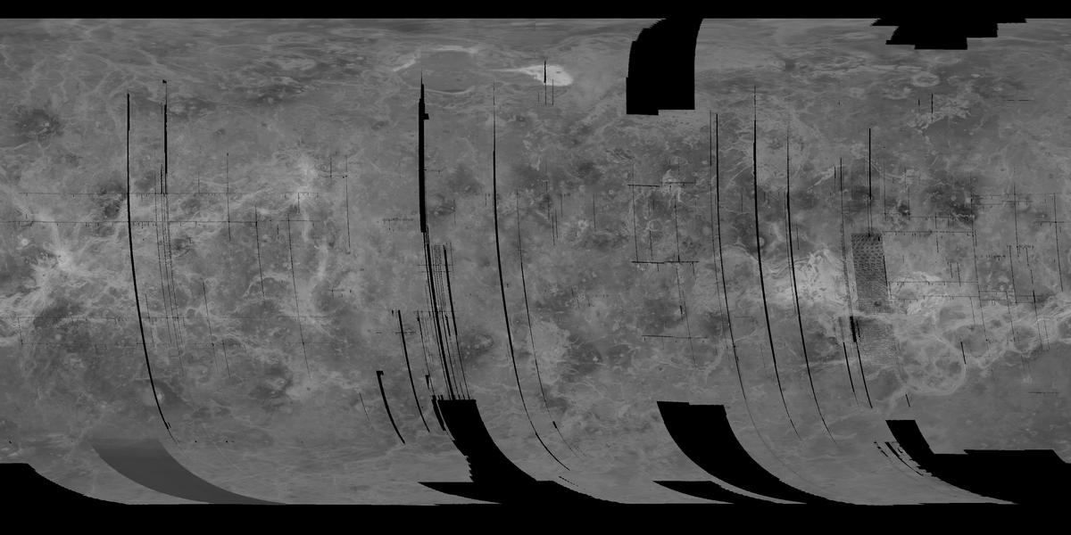
Mosaic of the "left-looking" data collected during cycle 1

Slide 18
Mapping cycle 1
The primary mission began on September 15, 1990, with the intention to provide a "left-looking" map of 70% of the Venusian surface at a minimum resolution of 1-kilometer/pixel.
During cycle 1, the altitude of the spacecraft varied from 2000-kilometers at the north pole, to 290-kilometers near periapsis.
Upon completion during May 15, 1991, having made 1,792 orbits, Magellan had mapped approximately 83.7% of the surface with a resolution between 101 and 250-meters/pixel.

Slide 19
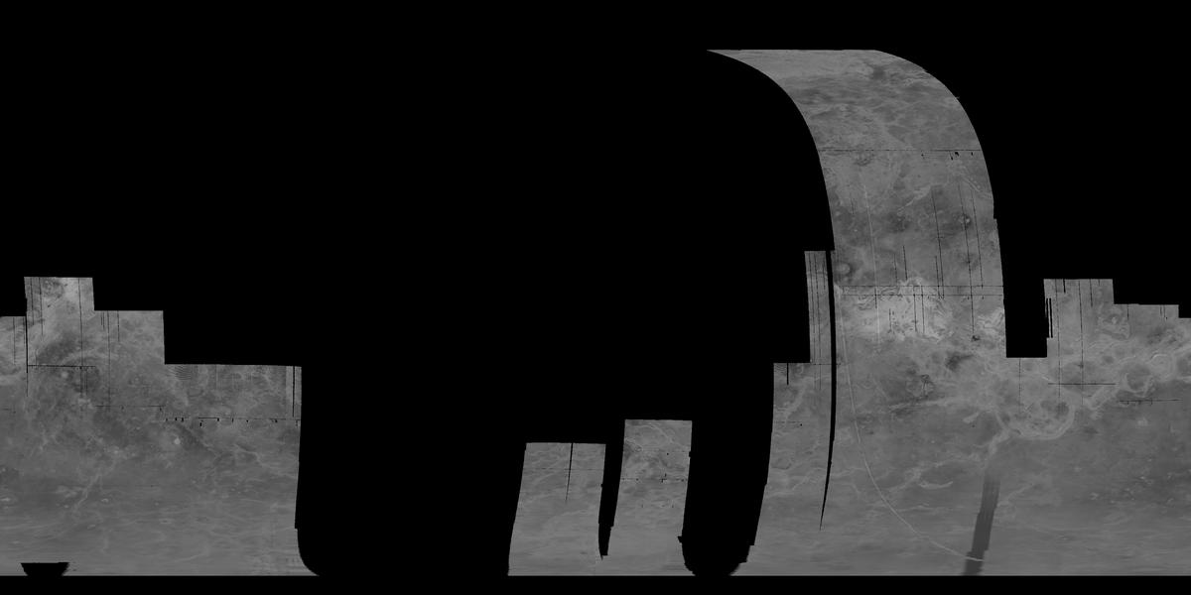
Mosaic of the "right-looking" data collected during cycle 2

Slide 20
Mapping cycle 2
Beginning immediately after the end of cycle 1, cycle 2 was intended to provide data for the existing gaps in the map collected during first cycle, including a large portion of the southern hemisphere.
Upon completion during mid-January 1992, cycle 2 provided data for 54.5% of the surface, and combined with the previous cycle, a map containing 96% of the surface could be constructed.

Slide 21
Mapping cycle 3
Immediately after cycle 2, cycle 3 began collecting data for stereo imagery on the surface that would later allow the ground team to construct, clear, three-dimensional renderings of the surface.
Map of the stereo imaging collected by Magellan during cycle 3

Slide 22
Mapping cycle 4
Goal: Measure Venus' gravitational field.
Upon completing cycle 3, Magellan ceased imaging the surface.
This constant signal allowed the DSN to collect information on the gravitational field of Venus by monitoring the velocity of the spacecraft.
The space craft completed 1,878 orbits until completion of the cycle on May 23, 1993; a loss of data at the beginning of the cycle necessitated an additional 10 days of gravitational study.

Slide 23
Mapping cycle 5
At the end of the fourth cycle in May 1993, the orbit of Magellan was circularized using a technique known as aerobraking.
The circularized orbit allowed a much higher resolution of gravimetric data to be acquired when cycle 5 began on August 3, 1993.
The spacecraft performed 2,855 orbits and provided high-resolution gravimetric data for 94% of the planet, before the end of the cycle on August 29, 1994.

Slide 24
Aerobraking
Aerobraking had long been sought as a method for slowing the orbit of interplanetary spacecraft.
Testing a new approach to the method, a plan was devised to drop the orbit of Magellan into the outermost region of the Venusian atmosphere.
Slight friction on the spacecraft slowed the velocity over a period, slightly longer than two months, bringing the spacecraft into an approximately circular orbit from 180-kilometers at periapsis to 540-kilometers at apoapsis.

Slide 25
Mapping cycle 6
Toward the end of the cycle, a final experiment was conducted, known as the "Windmill" experiment to provide data on the composition of the upper atmosphere of Venus.
Magellan performed 1,783 orbits before the end of the cycle on October 13, 1994, when the spacecraft entered the atmosphere and disintegrated.

Slide 26
Windmill experiment
Goal: Collect data on atmospheric dynamics.
September 6, 1994 - September 14, 1994
In September 1994, the orbit of Magellan was lowered to begin the "Windmill experiment".
Countering this force, the thrusters fired to keep the spacecraft from spinning.
This provided data on the basic oxygen gas-surface interaction.

Slide 27
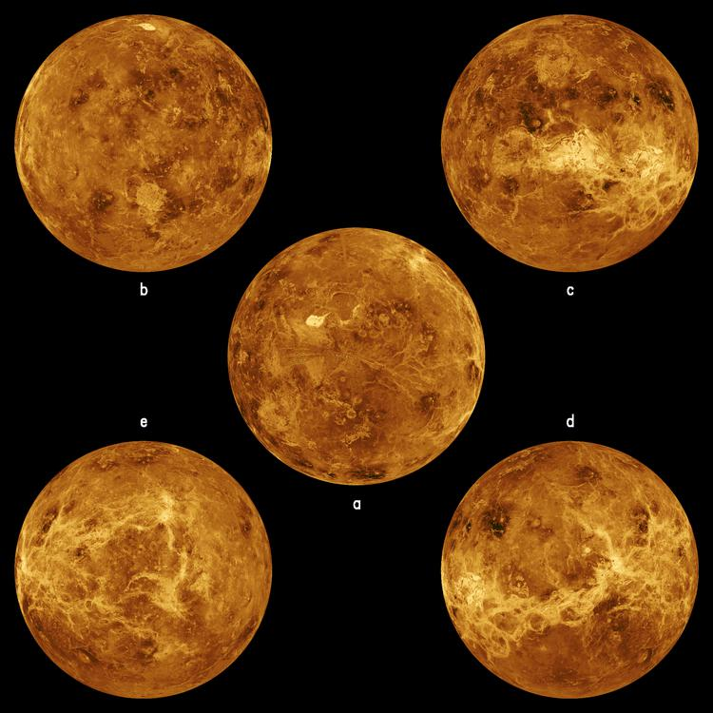
Five global views of Venus by Magellan

Slide 28
Results
The surface of Venus is mostly covered by volcanic materials.
Magellan's global radar map currently remains as the most detailed Venus map in existence, although the planned Russian Venera-D may carry a radar that can achieve the same, if not better resolution as the radar used by Magellan.
Maxwell Montes, highest point on Venus

Slide 29
End of mission
On September 9, 1994, a press release outlined the termination of the Magellan mission.
On October 13, 1994 at 10:05:00 UTC, communication was lost when the spacecraft entered radio occultation behind Venus.
The team continued to listen for another signal from the spacecraft until 18:00:00 UTC, when the mission was determined to have concluded.

Slide 30
See also
List of missions to Venus
Venera 15
Venera 16

Slide 31
External links
Magellan homepage
Magellan mission description and data
Magellan images
Magellan Mission Profile by NASA's Solar System Exploration

